Slide 1
Chapter 2
Data Representation Inside Computer System

Slide 2
Introduction Data Representation
A computer is an electronic device i.e. it works using electrical signals.
Electrical signals can represent only two states; on (1) and off (0).
Digital computers are made up of electronic circuits, which have exactly 2 states: on and off.
The organization of any computer depends considerably on how it represents numbers, characters, and control information.
So any information that has to be processed by a digital computer has to be converted in to a format which has two states (0 and 1).
In other word, computer processes any types of data using binary numbers.

Slide 3
Numeric Data Representation
Most extensively used number systems in the computer are two types:
1. No-positional number system
It is familiar with Roman Notation System.
In this system, each system represents the same value regardless of its position in the number.
The symbols are simply added to find out the resultant value of a particular number.
2. Positional number system
In a number system, there are only few symbols which represent different values depending on their positions.
The total number of different fundamental digits applicable to a number system is called its radix or base.
The most widely used number system is the positional number system..

Slide 4
Positional Number System
The positional number systems are
          Binary Number system(Base 2)
          Octal Number system(Base 8)
          Decimal Number system(Base 10)
          Hexadecimal Number system(Base 16)

Slide 5
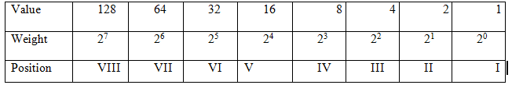
Binary Number system
The most popular form which is understood by the computer.
Its radix is 2.
It uses two digits i.e. 0 & 1.
Sometimes it is also called base-two system.
E.g. (110101)2

Slide 6
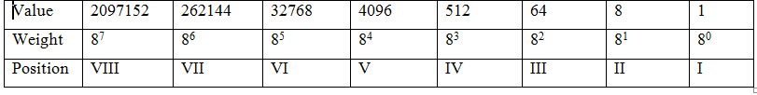
Octal Numbering System
It was once a popular number base, especially in the digital equipment like old computer systems.
It is rarely used today
It was developed to provide a short hand way to deal with the long strings of 1s and 0s created in the binary system.
The radix of octal is 8.
It uses eight digits i.e. 1, 2, 3, 4, 5, 6, and 7. As 2³ =8, an octal number is represented by a set of 3 bits. e.g. (57)₈

Slide 7
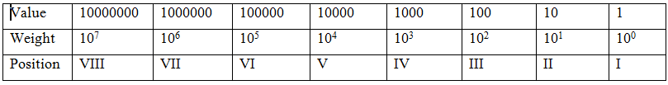
Decimal Numbering System
It is the most popular form of numbering system which is used by human being.
Its radix is 10.
It is also called base-ten system or natural number system.
It includes the numbers from 0-9.

Slide 8
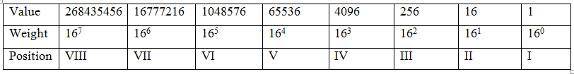
Hexadecimal Number System
Hex numbers are very compact
The hexadecimal system is based on the binary system using a Nibble or 4 bit boundary. The hexadecimal number system uses base 16
Includes only the digits 0 through 9 and the letters A, B, C, D, E, and F for the numbers starting from 10 to 15 respectively.

Slide 9
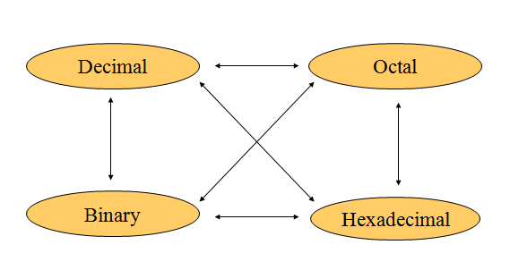
Conversion System

Slide 10
Binary To Decimal
Expand the given binary number in the power of 2 .
  (Multiply each bit by 2^{n}, where n is the “weight” of the bit)
Ex1: Convert (1001001)₂ to decimal
1x2⁶+0x2⁵+0x2⁴+1x2³+0x2²+0x2¹+1x2⁰
Ans. = (73)10
Ex2: Convert(10001)2 to decimal?
Ans.= (?)10

Slide 11
Decimal To Binary
Divide the decimal number by 2 until the reminder becomes zero or impossible to be divided by 2.
Ex 1: Convert (6)₁₀ to binary
Ans. = (110)₂
Ex 2: Convert(13)10 to Binary?
Ans. =(?)2

Slide 12
Binary To Octal
Group 3 binary digits together (preferable) but you can go from 2→10→8.
Ex 1. Convert (1001001)2 to octal
1001001=001 001 001
Ans. =(111)₈
Ex 2. Convert (101101001)2 to octal
Ans. = (?)₈

Slide 13
Octal To Binary
Each Octal digit is converted to 3 binary digits (preferable and simplest method) but you can go from 8→10→2
Ex 1. Convert (675)8 to binary
(6)₈ = (110) ₂ (7)₈= (111) ₂ (5)₈= (101) ₂
Ans. = (110111101)₂
Ex 2. Convert (231)₈ to binary
Ans. =(?)₂

Slide 14
Binary To Hexadecimal
Group 4 binary digits together (preferable and simplest method) .but you can go from 2→10→16.
Ex 1. Convert (111100100)2 to hexadecimal
111100100₂= (0001 1110 0100) ₂
(1 E 4) ₁₆
Ans.= (1E4)₁₆
Ex2. Convert(100111000101)2 to hexadecimal
_{Ans.=(?)16}

Slide 15
Hexadecimal To Binary
Each hexadecimal digit is converted to 4 binary digits(preferable and simplest method) but you can go from 16→10→2.
Ex1. Convert (234)₁₆ to binary
(2)₁₆ =0010₂
(3)₁₆= 0011₂
(4)₁₆=0100₂
Ans. = (1000110100)₂
Ex2. Convert 2AC₁₆ to binary
Ans.= (?)₂

Slide 16
Octal To Decimal
Go from 8→2→10 or Expand the octal number in power of 8.
Ex 1. Convert (234)₈ to decimal
Ans. = (156)10
Ex2. Convert (101)₈ to decimal
Ans. =(?)10

Slide 17
Decimal To Octal
Go from 10→2→8 or divide the decimal number by 8 until the quotient becomes zero.
Ex 1. Convert (78)₁₀ to base 8 (Octal)
Ans. =(116)₈
Ex 2. Convert (16)₁₀ to base 8 (Octal)
Ans. =(?)₈

Slide 18
Hexadecimal To Decimal
Go from 16→2→10 or Expand the hex-decimal number in power of 16.
Ex 1. Convert (A1B) ₁₆ to decimal
Ans. = (2587)10
Ex2. Convert (101)₁₆ to decimal
Ans. =(?)10

Slide 19
Decimal To Hexadecimal
Go from 10→2→16 or divide the decimal number by 16 until the quotient becomes zero.
Ex 1. Convert (30)₁₀ to base 16 (hex-decimal)
Ans.=(1E)₁₆
Ex2. Convert (16)₁₀ to base 16 (hexadecimal)
Ans. =(?)₁₆

Slide 20
Octal To Hexadecimal
Go from 8→2→16 (preferable and simplest method) but you can go from 8→10→16.
Ex.1. Convert 235₈ to hexadecimal
235₈=010 011 101
0000 1001 1101
0 9 13=D
Ans. =(?)₁₆

Slide 21
Hexadecimal To Octal
Go from 16→2→8 (preferable and simplest method) but you can go from 16→10→8
Ex.1. Convert 1A₁₆ to Octal
1₁₆=0001₂
A₁₆=1010₂
(000 011 010) ₂
(0 3 2)8
Ans. =(?)₈

Slide 22
Convert Decimal fraction to binary number
A) Convert the integral part of decimal to binary equivalent
steps
Divide the decimal number by 2 and store remainders in array.
Divide the quotient by 2.
Repeat step 2 until we get the quotient equal to zero.
Equivalent binary number would be reverse of all remainders of step 1.

Slide 23
Cont…
B) Convert the fractional part of decimal to binary equivalent
Steps
Multiply the fractional decimal number by 2.
Integral part of resultant decimal number will be first digit of fraction binary number.
Repeat step 1 using only fractional part of decimal number and then step 2.

Slide 24
Cont…
C) Combine both integral and fractional part of binary number which is the result.
Example convert (4.45)10 to binary
Step 1: Conversion of 4 to binary
4/2 : Remainder = 0 : Quotient = 2
2/2 : Remainder = 0 : Quotient = 1
1/2 : Remainder = 1 : Quotient = 0
So equivalent binary of integral part of decimal is 100.

Slide 25
Cont…
Step 2: Conversion of 0.45 to binary
0.45 * 2 = 0.90, Integral part is 0 and fractional part is .90
0.90 * 2 = 1.80, Integral part is 1 and fractional part is .80
0.80 * 2 = 1.60, Integral part is 1 and fractional part is .60
0.60*2=1.20, Integral part is 1 and fractional part is .20
0.20*2=0.40, Integral part is 0 and fractional part is .40
0.40*2=0.80, Integral part is 0 and fractional part is .80
Stop here because, it became redundant.
So equivalent binary of fractional part of decimal is .011100…
Step 3: Combined the result of step 1 and 2.
Final answer can be written as:
100 + .011100… = 100.011100..

Slide 26
Binary Arithmetic
Binary numbers can be added, subtracted, multiplied and divided like natural numbers-decimal numbers in which everybody uses them for day-to-day activities.
Let’s see how binary arithmetic is performed as the next slide

Slide 27
1.Binary addition
Rules
0+1=1
1+1=0 with carry 1 to the next digit
1+1+1=1 with carry 1 to the next digit
1+1+1+1=0 with carry 2 to the next digit
E.g. Add (10111)2 and (110101)2
Solution
110101
+10111
1001100

Slide 28
2.Binary subtraction
Rules
1-1=0
1-0=1
0-1=1 borrows 1 from the highest digit
E.g. Subtract (10101)2 from (101110)2
Solution
101110
-10101
11001
Binary subtraction can be also done using complements.
E.g. (1110-10101)2= (?)2
Solution
Rule: A-B=A+ (-B), where B is 2’s complement
2’s complement=1’s complement + 1
(10101)2 1’s complement= (01010)2 and its 2’s complement= (01011)2.
Then, apply the rule i.e. (1110 + 01011)2=(11001)2

Slide 29
3.Binary multiplication
Rules
1x1=1
0x1=0
E.g. Multiply (1111)2 by (111)2
Solution
1111
X 111
1111
1111
1111¬¬¬¬¬¬¬
(1101001)2

Slide 30
4.Binary division
This rule works for a number in which the remainder becomes zero. It may work for non-zero remainder numbers with some modifications.
Divide the dividend by the divisor until the remainder becomes zero or less than the divisor (impossible to be divided).
When you take two or three etc numbers of a dividend to add on the remainder part, you have to add one zero (0) or two (00) etc on the quotient respectively.
When you divide a number having fractional part, don’t worry about the fraction. Divide the number as it is an integer number.
But after you complete the division, count the number of fractional digits from left to right to both the dividend (D) and divisor (Df).
Then the number of fractional parts of the quotient (Qf) from left to right is equal to the difference between of D & Df.
Checking the result
Dividend=quotient * divisor + remainder

Slide 31
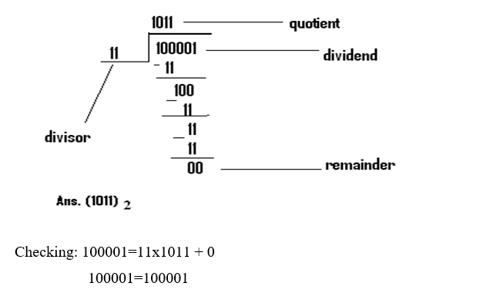
Cont…
E.g.1. Divide (100001)2 by (11)2
Solution
E.g. 2. Divide (1011.01)2 by (10.1)2

Slide 32
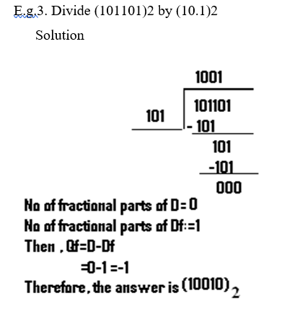
Cont…
Note:
If the difference between D & Df is negative, add zero(s) as many as the number of the difference on the right side of the quotient.
Let’s see it with an example.

Slide 33
Signed And Two’s Complement
The conversions we have so far presented have involved only positive numbers.
To represent negative values, computer systems allocate the high-order bit to indicate the sign of a value. It is also called the most significant bit.
The remaining bits contain the value of the number.
There are three ways in which signed binary numbers may be expressed:
  Signed magnitude.
  One’s complement.
  Two’s complement.

Slide 34
One’s Complement Representation
One’s complement is another way to represent signed integers.
To encode a negative number, get the binary representation of its magnitude, then complement each bit.
All the 1 bits is changed to 0 and all the 0 bit is changed to 1 to get the complement of a number.
One’s Complement of the number is treated as the negative of that number.
Example:
        +5=0 101
        -5=1 101=1 010 (One’s complement)

Slide 35
Two’s Complement Representation
Two’s complement is another way to represent signed integers.
To encode a negative number, get the binary representation of its magnitude, complement each bit, then add 1. (get One’s complement, then add 1).
Two’s complement of a number is one’s complement of a number+ 1.
Two’s complement of a number is treated as the negative representation of the number.
Example:
        +5 = 0 101
        -5=1 101=1 010=1 011
Therefore -5 = 1011(Two’s complement)

Slide 36
Computer Codes or coding method
Computer handles different types of data namely Numeric data, alphanumeric data, alphabetic data and etc.
Computer system use a binary system for data representation; Two digits 0 and 1, refer to the presence and absence of electric current or pulse of light.
All data and programs that go into the computer are represented in terms of these numbers.
Computer system encodes the data by means of binary or digital coding schemes to represent letters, numbers and special characters.
Some of the commonly used schemes are BCD,EBCDIC, ASCII, and Unicode.

Slide 37
BCD (Binary coded Decimal)
Binary-coded decimal is a system of writing numerals that assigns a four-digit binary code to each digit 0 through 9 in a decimal (base 10) number.
Simply put, binary-coded decimal is a way to convert decimal numbers into their binary equivalents.
It is one of the early memory code and with BCD each digit of a decimal number is converted into its binary equivalent rather than converting the entire decimal value into binary form.
In the BCD, with four bits we can represent sixteen numbers (0000 to 1111). But in BCD code only first ten of these are used (0000 to 1001). The remaining six code combinations i.e. 1010 to 1111 are invalid in BCD.

Slide 38
Cont…
E.g.(42)10 is not equal to (101010)2 in BCD but, it is equal to (0100 0010)2. (Here (4)10 = 0100 and (2)10 = 0010)
Therefore
(9)10 = 1001 in BCD
(1)10 = 0001 in BCD
10(1+0)10 = 0001 0000 in BCD
15(1+5)10 = 0001 0101 in BCD

Slide 39
Cont…
Since 4 bits is insufficient to represent characters, 6 bits representation was introduced in BCD coding.
6 bit is enough to represent 10 decimal digits, 26 alphabetic letters and 28 other special characters.
6 bit BCD code can be easily divided into 3 bit groups and each group can be represented by 1 octal digit.
Thus octal number is used as shortcut notation in BCD coding.
In BCD coding the letter BASE is represented as 110 010 110 001 010 010 110 101

Slide 40
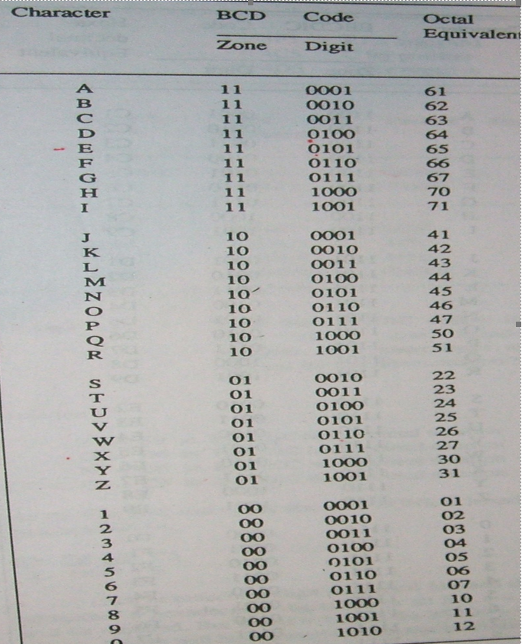
Cont…

Slide 41
EBCDIC (Extended Binary Coded Decimal Interchange Code)
Using 6 bits BCD can represent only 64 characters. To represent lowercase alphabets (26), uppercase alphabets (26), decimal numbers (10) and special characters (28+) BCD coding is not sufficient and was extended from 6 bit to 8 bit. And the new coding scheme is EBCDIC.
EBCDIC using 8 bits can represent 28 (=256) different characters. EBCDIC 8 bit coding can be divided into 2 groups of 4 bits. Each group can be represented using 1 hexa decimal digit.
This scheme is developed by IBM and hence mostly used in IBM model computer and mainframe.

Slide 42
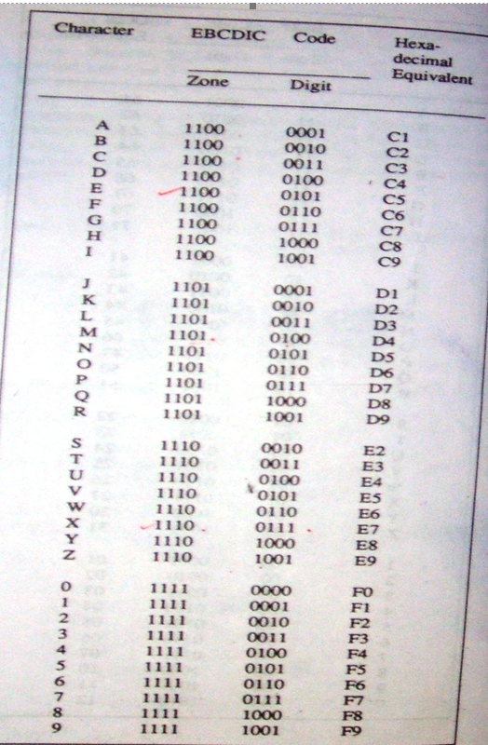
Cont…

Slide 43
ASCII (American Standard Code For Information Interchange
Short for American Standard Code for Information Interexchange (ASCII).
It is the binary code used in most of the microcomputers. This binary scheme originally used 7 bits to from a character and so known as ASCII- 7 coding scheme which can represent only 27 (=128) different characters.
To provide more possible combinations with which to form other characters and symbols. Extended ASCII or ASCII-8 was introduced.
ASCII-8 use 8 bits to form a character and can represent 28 (=256) different characters.
ASCII is a standard that assigns letters, numbers, and other characters in the 256 slots available in the 8-bit code. The ASCII decimal (Dec) number is created from binary, which is the language of all computers.
It is a code for representing 128 English characters as numbers, with each letter assigned a number from 0 to 127.
ASCII encoding scheme uses hexa decimal for its shortcut notation.

Slide 44
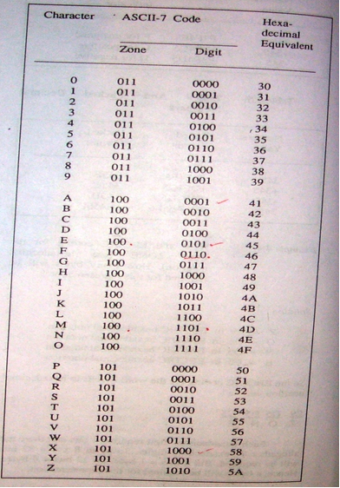
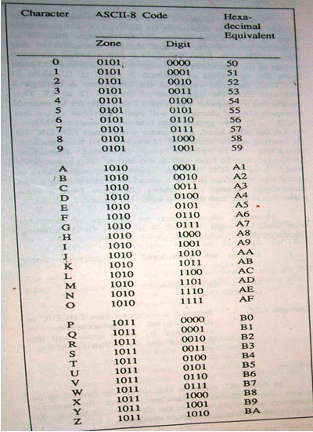
Cont…

Slide 45
Unicode
Unicode, binary coding scheme uses 2 byte for each character instead of 1 byte. Unicode can handle 216 (=65,536) character combinations.
BCD, EBCDIC, ASCII 7, and ASCII 8 coding schemes for all numeric and alphabetic characters are listed below.

